Slide 1

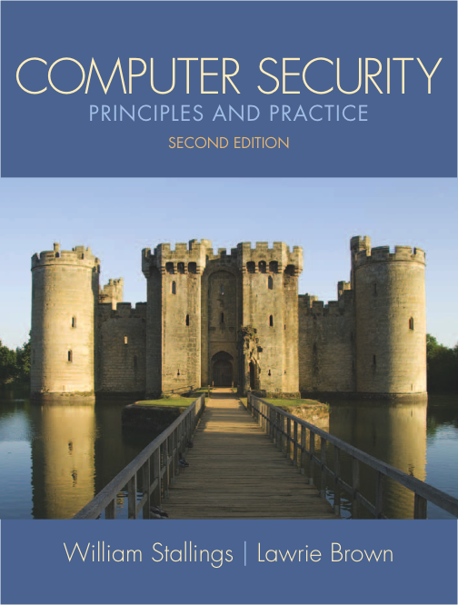
Lecture 1: Overview
modified from slides of Lawrie Brown
Notes:
This chapter provides an overview of computer security. We begin with a discussion of what we mean by computer security. In essence, computer security deals with computer-related assets that are subject to a variety of threats and for which various measures are taken to protect those assets. Accordingly, the next section of this chapter provides a brief overview of the categories of computer-related assets that users and system managers wish to preserve and protect, and a look at the various threats and attacks that can be made on those assets. Then, we survey the measures that can be taken to deal with such threats and attacks. This we do from three different viewpoints, in Sections 1.3 through 1.5 . We then look at some recent trends in computer security and lay out in general terms a computer security strategy.

Slide 2
Introduction
Instructor: Osama Hosam
Course Website:
http://osama-hosam.blogspot.com/p/comsec.html

Slide 3
Outline
The focus of this chapter is on three fundamental questions:
What assets do we need to protect?
How are those assets threatened?
What can we do to counter those threats?
Notes:
The focus of this chapter, and indeed this book, is on three fundamental questions:
1. What assets do we need to protect?
2. How are those assets threatened?
3. What can we do to counter those threats?

Slide 4
Computer Security Overview
The NIST Computer Security Handbook defines the term Computer Security as:
“The protection afforded to an automated information system in order to attain the applicable objectives of preserving the integrity, availability and confidentiality of information system resources”
includes hardware, software, firmware, information/data, and telecommunications.
Notes:
The NIST Computer Security Handbook [NIST95] defines the term computer security as follows:
Computer Security: The protection afforded to an automated information system in order to attain the applicable objectives of preserving the integrity, availability, and confidentiality of information system resources (includes hardware, software, firmware, information/data, and telecommunications).
This definition introduces three key objectives that are at the heart of computer security:
• Confidentiality: This term covers two related concepts:
— Data confidentiality : 1 Assures that private or confidential information is
not made available or disclosed to unauthorized individuals.
— Privacy : Assures that individuals control or influence what information
related to them may be collected and stored and by whom and to whom
that information may be disclosed.
• Integrity: This term covers two related concepts:
— Data integrity : Assures that information and programs are changed only
in a specified and authorized manner.
— System integrity : Assures that a system performs its intended function in
an unimpaired manner, free from deliberate or inadvertent unauthorized
manipulation of the system.
• Availability: Assures that systems work promptly and service is not denied to
authorized users.

Slide 5
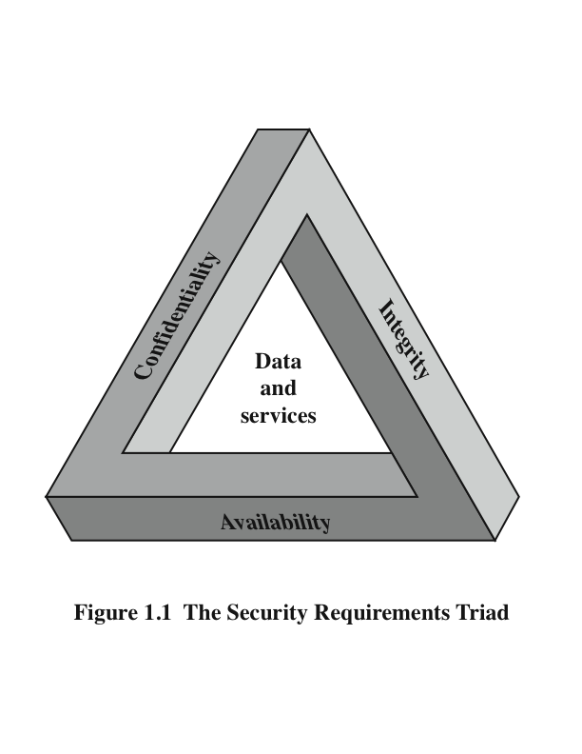
The CIA Triad
Notes:
These three concepts form what is often referred to as the CIA triad
( Figure 1.1 ). The three concepts embody the fundamental security objectives for both data and for information and computing services.
For example, the NIST standard FIPS 199 ( Standards for Security Categorization of Federal Information and Information Systems ) lists confidentiality, integrity, and availability as the three security objectives for information and for information systems.

Slide 6
Key Security Concepts
Confidentiality
Integrity
Availability
preserving authorized restrictions on information access and disclosure.
including means for protecting personal privacy and proprietary information
guarding against improper information modification or destruction,
including ensuring information nonrepudiation and authenticity
ensuring timely and reliable access to and use of information
Is this all?
Notes:
FIPS PUB 199
provides a useful characterization of these three objectives in terms of requirements and the definition of a loss of security in each category:
• Confidentiality: Preserving authorized restrictions on information access and disclosure, including means for protecting personal privacy and proprietary information. A loss of confidentiality is the unauthorized disclosure of
information.
• Integrity: Guarding against improper information modification or destruction, including ensuring information non-repudiation and authenticity. A loss of integrity is the unauthorized modification or destruction of information.
• Availability: Ensuring timely and reliable access to and use of information. A loss of availability is the disruption of access to or use of information or an information system.
Although the use of the CIA triad to define security objectives is well established, some in the security field feel that additional concepts are needed to present a complete picture. Two of the most commonly mentioned are as follows:
• Authenticity: The property of being genuine and being able to be verified and trusted; confidence in the validity of a transmission, a message, or message originator. This means verifying that users are who they say they are and that each input arriving at the system came from a trusted source.
• Accountability: The security goal that generates the requirement for actions of an entity to be traced uniquely to that entity. This supports nonrepudiation, deterrence, fault isolation, intrusion detection and prevention, and after-action recovery and legal action. Because truly secure systems aren’t yet an achievable goal, we must be able to trace a security breach to a responsible party. Systems must keep records of their activities to permit later forensic analysis to trace security breaches or to aid in transaction disputes.
Note that FIPS PUB 199 includes authenticity under integrity.

Slide 7
Computer Security Terminology
Adversary (threat agent)
An entity that attacks, or is a threat to, a system.
Attack
An assault on system security that derives from an intelligent threat; a deliberate attempt to evade security services and violate security policy of a system.
Countermeasure
An action, device, procedure, or technique that reduces a threat, a vulnerability, or an attack by eliminating or preventing it, by minimizing the harm it can cause, or by discovering and reporting it so that corrective action can be taken.
Notes:
We now introduce some terminology that will be useful throughout the book, relying on RFC 2828, Internet Security Glossary . 3 Table 1.1 defines terms.
Adversary (threat agent) - An entity that attacks, or is a threat to, a system.
Attack -An assault on system security that derives from an intelligent threat; a deliberate attempt to evade security services and violate security policy of a system.
Countermeasure - An action, device, procedure, or technique that reduces a threat, a vulnerability, or an attack by eliminating or preventing it, by minimizing the harm it can cause, or by discovering and reporting it so that corrective action can be taken.
Risk - An expectation of loss expressed as the probability that a particular threat will exploit a particular vulnerability with a particular harmful result.
Security Policy - A set of rules and practices that specify how a system or org provides security services to protect sensitive and critical system resources.
System Resource (Asset) - Data; a service provided by a system; a system capability; an item of system equipment; a facility that houses system operations and equipment.
Threat - A potential for violation of security, which exists when there is a circumstance, capability, action, or event that could breach security and cause harm.
Vulnerability - Flaw or weakness in a system's design, implementation, or operation and management that could be exploited to violate the system's security policy.

Slide 8
Computer Security Terminology
Risk
An expectation of loss expressed as the probability that a particular threat will exploit a particular vulnerability with a particular harmful result.
Security Policy
A set of rules and practices that specify how a system or org provides security services to protect sensitive and critical system resources.
System Resource (Asset)
Data; a service provided by a system; a system capability; an item of system equipment; a facility that houses system operations and equipment.
Notes:
We now introduce some terminology that will be useful throughout the book, relying on RFC 2828, Internet Security Glossary . 3 Table 1.1 defines terms.

Slide 9
Computer Security Terminology
Threat
A potential for violation of security, which exists when there is a circumstance, capability, action, or event that could breach security and cause harm.
Vulnerability
Flaw or weakness in a system's design, implementation, or operation and management that could be exploited to violate the system's security policy.
Notes:
We now introduce some terminology that will be useful throughout the book, relying on RFC 2828, Internet Security Glossary . 3 Table 1.1 defines terms.

Slide 10
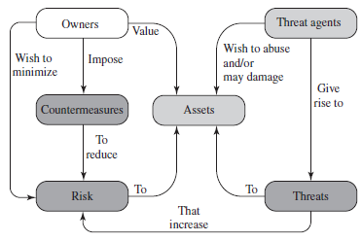

Security Concepts and Relationships
Notes:
Figure 1.2 [CCPS04a] shows the relationship among some terminology that will be useful throughout the book, drawn from RFC 2828, Internet Security Glossary:

Slide 11
Vulnerabilities, Threats and Attacks
vulnerabilities
leaky (loss of confidentiality)
corrupted (loss of integrity)
unavailable or very slow (loss of availability)
threats
capable of exploiting vulnerabilities
represent potential security harm
attacks (threats carried out)
passive or active attempt to alter/affect system resources
insider or outsider
Notes:
In the context of security, our concern is with the vulnerabilities of system resources. [NRC02] lists the following general categories of vulnerabilities of a computer system or network asset:
• It can be corrupted , so that it does the wrong thing or gives wrong answers.
For example, stored data values may differ from what they should be because they have been improperly modified.
• It can become leaky . For example, someone who should not have access to some or all of the information available through the network obtains such access.
• It can become unavailable or very slow. That is, using the system or network becomes impossible or impractical.
These three general types of vulnerability correspond to the concepts of integrity, confidentiality, and availability, enumerated earlier in this section.
Corresponding to the various types of vulnerabilities to a system resource are threats that are capable of exploiting those vulnerabilities. A threat represents a potential security harm to an asset. An attack is a threat that is carried out (threat action) and, if successful, leads to an undesirable violation of security, or threat consequence. The agent carrying out the attack is referred to as an attacker, or threat agent . We can distinguish two types of attacks:
• Active attack: An attempt to alter system resources or affect their operation.
• Passive attack: An attempt to learn or make use of information from the system that does not affect system resources.
We can also classify attacks based on the origin of the attack:
• Inside attack: Initiated by an entity inside the security perimeter (an “insider”). The insider is authorized to access system resources but uses them in a way not approved by those who granted the authorization.
• Outside attack: Initiated from outside the perimeter, by an unauthorized or illegitimate user of the system (an “outsider”). On the Internet, potential outside attackers range from amateur pranksters to organized criminals, international terrorists, and hostile governments.

Slide 12
Types of Attackers
Notes:
Computer security is both fascinating and complex. Some of the reasons follow:
1. Computer security is not as simple as it might first appear to the novice. The requirements seem to be straightforward, but the mechanisms used to meet those requirements can be quite complex and subtle.
2. In developing a particular security mechanism or algorithm, one must always consider potential attacks (often unexpected) on those security features.
3. Hence procedures used to provide particular services are often counterintuitive.
4. Having designed various security mechanisms, it is necessary to decide where to use them.
5. Security mechanisms typically involve more than a particular algorithm or protocol, but also require participants to have secret information, leading to issues of creation, distribution, and protection of that secret information.
6. Computer security is essentially a battle of wits between a perpetrator who tries to find holes and the designer or administrator who tries to close them.
7. There is a natural tendency on the part of users and system managers to perceive little benefit from security investment until a security failure occurs.
8. Security requires regular monitoring, difficult in today's short-term environment.
9. Security is still too often an afterthought - incorporated after the design is complete.
10. Many users / security administrators view strong security as an impediment to efficient and user-friendly operation of an information system or use of information.

Slide 13
Passive and Active Attacks
Passive attacks attempt to learn or make use of information from the system but does not affect system resources
eavesdropping/monitoring transmissions
difficult to detect
emphasis is on prevention rather than detection
two types:
message contents
traffic analysis
Active attacks involve modification of the data stream
goal is to detect them and then recover
four categories:
masquerade
replay
modification of messages
denial of service
Notes:
COMMUNICATION LINES AND NETWORKS
Network security attacks can be classified as passive attacks and active attacks . A passive attack attempts to learn or make use of information from the system but does not affect system resources. An active attack attempts to alter system resources or affect their operation.
Passive attacks are in the nature of eavesdropping on, or monitoring of, transmissions. The goal of the attacker is to obtain information that is being transmitted. Two types of passive attacks are release of message contents and traffic analysis.
The release of message contents is easily understood. A telephone conversation, an electronic mail message, and a transferred file may contain sensitive or confidential information. We would like to prevent an opponent from learning the contents of these transmissions.
A second type of passive attack, traffic analysis , is subtler. Suppose that we had a way of masking the contents of messages or other information traffic so that opponents, even if they captured the message, could not extract the information from the message. The common technique for masking contents is encryption. If we had encryption protection in place, an opponent might still be able to observe the pattern of these messages. The opponent could determine the location and identity of communicating hosts and could observe the frequency and length of messages being exchanged. This information might be useful in guessing the nature of the communication that was taking place.
Passive attacks are very difficult to detect because they do not involve any alteration of the data. Typically, the message traffic is sent and received in an apparently normal fashion and neither the sender nor receiver is aware that a third party has read the messages or observed the traffic pattern. However, it is feasible to prevent the success of these attacks, usually by means of encryption.
Thus, the emphasis in dealing with passive attacks is on prevention rather than detection.
Active attacks involve some modification of the data stream or the creation of a false stream and can be subdivided into four categories: replay, masquerade, modification of messages, and denial of service.
Replay involves the passive capture of a data unit and its subsequent retransmission to produce an unauthorized effect.
A masquerade takes place when one entity pretends to be a different entity. A masquerade attack usually includes one of the other forms of active attack. For example, authentication sequences can be captured and replayed after a valid authentication sequence has taken place, thus enabling an authorized entity with few privileges to obtain extra privileges by impersonating an entity that has those privileges.
Modification of messages simply means that some portion of a legitimate message is altered, or that messages are delayed or reordered, to produce an unauthorized effect. For example, a message stating, “Allow John Smith to read confidential file accounts” is modified to say, “Allow Fred Brown to read confidential file accounts.”
The denial of service prevents or inhibits the normal use or management of communications facilities. This attack may have a specific target; for example, an entity may suppress all messages directed to a particular destination (e.g., the security audit service). Another form of service denial is the disruption of an entire network, either by disabling the network or by overloading it with messages so as to degrade performance.
Active attacks present the opposite characteristics of passive attacks. Whereas passive attacks are difficult to detect, measures are available to prevent their success. On the other hand, it is quite difficult to prevent active attacks absolutely, because to do so would require physical protection of all communications facilities and paths at all times. Instead, the goal is to detect them and to recover from any disruption or delays caused by them. Because the detection has a deterrent effect, it may also contribute to prevention.

Slide 14
Types of Threats
Notes:
Computer security is both fascinating and complex. Some of the reasons follow:
1. Computer security is not as simple as it might first appear to the novice. The requirements seem to be straightforward, but the mechanisms used to meet those requirements can be quite complex and subtle.
2. In developing a particular security mechanism or algorithm, one must always consider potential attacks (often unexpected) on those security features.
3. Hence procedures used to provide particular services are often counterintuitive.
4. Having designed various security mechanisms, it is necessary to decide where to use them.
5. Security mechanisms typically involve more than a particular algorithm or protocol, but also require participants to have secret information, leading to issues of creation, distribution, and protection of that secret information.
6. Computer security is essentially a battle of wits between a perpetrator who tries to find holes and the designer or administrator who tries to close them.
7. There is a natural tendency on the part of users and system managers to perceive little benefit from security investment until a security failure occurs.
8. Security requires regular monitoring, difficult in today's short-term environment.
9. Security is still too often an afterthought - incorporated after the design is complete.
10. Many users / security administrators view strong security as an impediment to efficient and user-friendly operation of an information system or use of information.

Slide 15
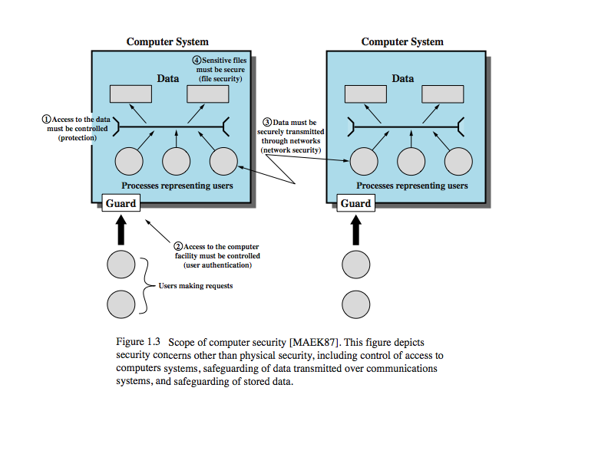
Scope of Computer Security
Notes:
The assets of a computer system can be categorized as hardware, software, data, and communication lines and networks. In this subsection, we briefly describe these four categories and relate these to the concepts of integrity, confidentiality, and availability introduced in Section 1.1 (see Figure 1.3 and Table 1.3 ).

Slide 16
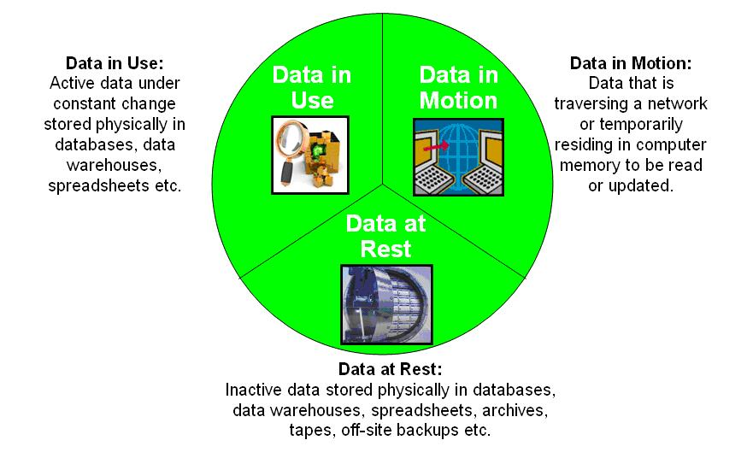
States of Data
Notes:
The assets of a computer system can be categorized as hardware, software, data, and communication lines and networks. In this subsection, we briefly describe these four categories and relate these to the concepts of integrity, confidentiality, and availability introduced in Section 1.1 (see Figure 1.3 and Table 1.3 ).

Slide 17
Types of user data to be protected
Notes:
AUTHENTICATION
The authentication service is concerned with assuring that a communication is authentic. In the case of a single message, such as a warning or alarm signal, the function of the authentication service is to assure the recipient that the message is from the source that it claims to be from. In the case of an ongoing interaction, such as the connection of a terminal to a host, two aspects are involved. First, at the time of connection initiation, the service assures that the two entities are authentic, that is, that each is the entity that it claims to be. Second, the service must assure that the connection is not interfered with in such a way that a third party can masquerade as one of the two legitimate parties for the purposes of unauthorized transmission or reception.
Two specific authentication services are defined in the standard:
• Peer entity authentication: Provides for the corroboration of the identity of a peer entity in an association. Two entities are considered peer if they implement the same protocol in different systems (e.g., two TCP users in two communicating systems). Peer entity authentication is provided for use at the establishment of, or at times during the data transfer phase of, a connection. It attempts to provide confidence that an entity is not performing either a masquerade or an unauthorized replay of a previous connection.
• Data origin authentication: Provides for the corroboration of the source of a data unit. It does not provide protection against the duplication or modification of data units. This type of service supports applications like electronic mail where there are no prior interactions between the communicating entities.

Slide 18
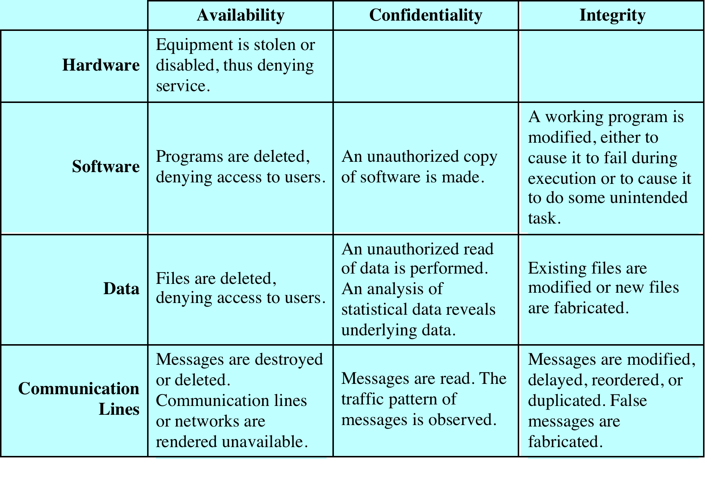
Computer and Network Assets
Notes:
HARDWARE A major threat to computer system hardware is the threat to availability. Hardware is the most vulnerable to attack and the least susceptible to automated controls. Threats include accidental and deliberate damage to equipment as well as theft. The proliferation of personal computers and workstations and the widespread use of LANs increase the potential for losses in this area. Theft of CD-ROMs and DVDs can lead to loss of confidentiality. Physical and administrative security measures are needed to deal with these threats.
SOFTWARE Software includes the operating system, utilities, and application programs. A key threat to software is an attack on availability. Software, especially application software, is often easy to delete. Software can also be altered or damaged to render it useless. Careful software configuration management, which includes making backups of the most recent version of software, can maintain high availability. A more difficult problem to deal with is software modification that results in a program that still functions but that behaves differently than before, which is a threat to integrity/authenticity. Computer viruses and related attacks fall into this category. A final problem is protection against software piracy. Although certain countermeasures are available, by and large the problem of unauthorized copying of software has not been solved.
DATA Hardware and software security are typically concerns of computing center professionals or individual concerns of personal computer users. A much more widespread problem is data security, which involves files and other forms of data controlled by individuals, groups, and business organizations. Security concerns with respect to data are broad, encompassing availability, secrecy, and integrity. In the case of availability, the concern is with the destruction of data files, which can occur either accidentally or maliciously.
The obvious concern with secrecy is the unauthorized reading of data files or databases, and this area has been the subject of perhaps more research and effort than any other area of computer security. A less obvious threat to secrecy involves the analysis of data and manifests itself in the use of so-called statistical databases, which provide summary or aggregate information. Presumably, the existence of aggregate information does not threaten the privacy of the individuals involved. However, as the use of statistical databases grows, there is an increasing potential for disclosure of personal information. In essence, characteristics of constituent individuals may be identified through careful analysis. For example, if one table records the aggregate of the incomes of respondents A, B, C, and D and another records the aggregate of the incomes of A, B, C, D, and E, the difference between the two aggregates would be the income of E. This problem is exacerbated by the increasing desire to combine data sets. In many cases, matching several sets of data or consistency at different levels of aggregation requires access to individual units. Thus, the individual units, which are the subject of privacy concerns, are available at various stages in the processing of data sets.
Finally, data integrity is a major concern in most installations. Modifications to data files can have consequences ranging from minor to disastrous.

Slide 19
Security Funtional Requirements
computer security technical measures
management controls and procedures
overlap computer security technical measures and management controls
access control
identification & authentication;
system & communication protection
system & information integrity
awareness & training
audit & accountability
certification, accreditation, & security assessments
contingency planning
maintenance
physical & environmental protection
planning
personnel security
risk assessment
systems & services acquisition
configuration management
incident response
media protection
Notes:
There are a number of ways of classifying and characterizing the countermeasures that may be used to reduce vulnerabilities and deal with threats to system assets. It will be useful for the presentation in the remainder of the book to look at several approaches, which we do in this and the next two sections. In this section, we view countermeasures in terms of functional requirements, and we follow the classification defined in FIPS PUB 200 ( Minimum Security Requirements for Federal Information and Information Systems ). This standard enumerates 17 security-related areas with regard to protecting the confidentiality, integrity, and availability of information systems and the information processed, stored, and transmitted by those systems.
The requirements listed in FIP PUB 200 encompass a wide range of countermeasures to security vulnerabilities and threats. Roughly, we can divide these countermeasures into two categories: those that require computer security technical measures (covered in this book in Parts One and Two), either hardware or software, or both; and those that are fundamentally management issues (covered in Part Three).
Each of the functional areas may involve both computer security technical measures and management measures. Functional areas that primarily require computer security technical measures include access control, identification and authentication, system and communication protection, and system and information integrity. Functional areas that primarily involve management controls and procedures include awareness and training; audit and accountability; certification, accreditation, and security assessments; contingency planning; maintenance; physical and environmental protection; planning; personnel security; risk assessment; and systems and services acquisition. Functional areas that overlap computer security technical measures and management controls include configuration management, incident response, and media protection.
Note that the majority of the functional requirements areas in FIP PUB 200 are either primarily issues of management or at least have a significant management component, as opposed to purely software or hardware solutions. This may be new to some readers and is not reflected in many of the books on computer and information security. But as one computer security expert observed, “If you think technology can solve your security problems, then you don’t understand the problems and you don’t understand the technology” [SCHN00]. This book reflects the need to combine technical and managerial approaches to achieve effective computer security.
FIPS PUB 200 provides a useful summary of the principal areas of concern, both technical and managerial, with respect to computer security.

Slide 20
Security Implementation
prevention
detection
complementary courses of action
recovery
response
Notes:
Security implementation involves four complementary courses of action:
• Prevention: An ideal security scheme is one in which no attack is successful.
Although this is not practical in all cases, there is a wide range of threats in
which prevention is a reasonable goal. For example, consider the transmission
of encrypted data. If a secure encryption algorithm is used, and if measures
are in place to prevent unauthorized access to encryption keys, then attacks on
confidentiality of the transmitted data will be prevented.
• Detection: In a number of cases, absolute protection is not feasible, but it is
practical to detect security attacks. For example, there are intrusion detection
systems designed to detect the presence of unauthorized individuals logged
onto a system. Another example is detection of a denial of service attack, in
which communications or processing resources are consumed so that they are
unavailable to legitimate users.
• Response: If security mechanisms detect an ongoing attack, such as a denial of
service attack, the system may be able to respond in such a way as to halt the
attack and prevent further damage.
• Recovery: An example of recovery is the use of backup systems, so that if data
integrity is compromised, a prior, correct copy of the data can be reloaded.

Slide 21
Security Mechanism
Feature designed to
Prevent attackers from violating security policy
Detect attackers’ violation of security policy
Response to mitigate attack
Recover, continue to function correctly even if attack succeeds
No single mechanism that will support all services
Authentication, authorization, availability, confidentiality, integrity, non-repudiation
Notes:
Security Mechanisms
Table 1.6 lists the security mechanisms defined in X.800. The mechanisms are
divided into those that are implemented in a specific protocol layer, such as TCP
or an application-layer protocol, and those that are not specific to any particular
protocol layer or security service. These mechanisms will be covered in the appropriate
places in the book and so we do not elaborate now, except to comment on the
definition of encipherment. X.800 distinguishes between reversible encipherment
mechanisms and irreversible encipherment mechanisms. A reversible encipherment
mechanism is an encryption algorithm that allows data to be encrypted and subsequently
decrypted. Irreversible encipherment mechanisms include hash algorithms
and message authentication codes, which are used in digital signature and message
authentication applications.

Slide 22
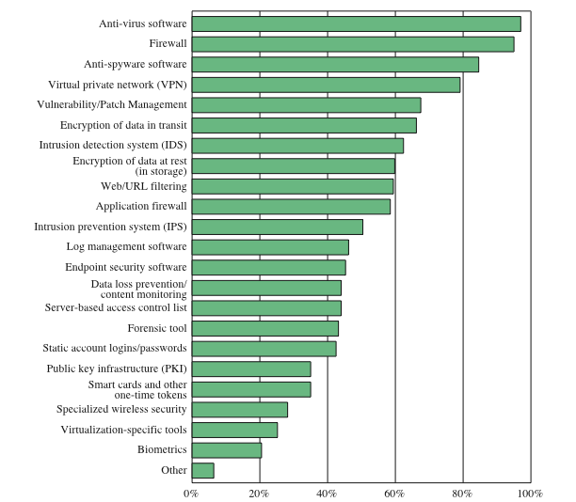
Security Technologies Used
Notes:
Figure 1.5 indicates the types of security technology used by organizations to
counter threats. Both firewalls and antivirus software are used almost universally.
This popularity reflects a number of factors:
• The maturity of these technologies means that security administrators are
very familiar with the products and are confident of their effectiveness.
• Because these technologies are mature and there are a number of vendors, costs
tend to be quite reasonable and user-friendly interfaces are available.
• The threats countered by these technologies are among the most significant
facing security administrators.

Slide 23
Computer Security Strategy
Specification & policy
Implementation & mechanisms
Correctness & assurance
what is the security scheme supposed to do?
how does it do it?
does it really work?
Notes:
We conclude this chapter with a brief look at the overall strategy for providing
computer security. [LAMP04] suggests that a comprehensive security strategy
involves three aspects:
• Specification/policy: What is the security scheme supposed to do?
• Implementation/mechanisms: How does it do it?
• Correctness/assurance: Does it really work?

Slide 24
Security Policy
formal statement of rules and practices that specify or regulate security services
factors to consider:
value of the protected assets
vulnerabilities of the system
potential threats and the likelihood of attacks
trade-offs to consider:
ease of use versus security
cost of security versus cost of failure and recovery
Notes:
The first step in devising security services and mechanisms is to develop a security
policy. Those involved with computer security use the term security policy in
various ways. At the least, a security policy is an informal description of desired
system behavior [NRC91]. Such informal policies may reference requirements for
security, integrity, and availability. More usefully, a security policy is a formal statement
of rules and practices that specify or regulate how a system or organization
provides security services to protect sensitive and critical system resources (RFC
2828). Such a formal security policy lends itself to being enforced by the system’s
technical controls as well as its management and operational controls.
In developing a security policy, a security manager needs to consider the
following factors:
• The value of the assets being protected
• The vulnerabilities of the system
• Potential threats and the likelihood of attacks
Further, the manager must consider the following trade-offs:
• Ease of use versus security: Virtually all security measures involve some penalty
in the area of ease of use. The following are some examples. Access control
mechanisms require users to remember passwords and perhaps perform other
access control actions. Firewalls and other network security measures may
reduce available transmission capacity or slow response time. Virus-checking
software reduces available processing power and introduces the possibility of
system crashes or malfunctions due to improper interaction between the security
software and the operating system.
• Cost of security versus cost of failure and recovery: In addition to ease of use
and performance costs, there are direct monetary costs in implementing and
maintaining security measures. All of these costs must be balanced against the
cost of security failure and recovery if certain security measures are lacking.
The cost of security failure and recovery must take into account not only the
value of the assets being protected and the damages resulting from a security
violation, but also the risk, which is the probability that a particular threat will
exploit a particular vulnerability with a particular harmful result.
Security policy is thus a business decision, possibly influenced by legal requirements.

Slide 25
Security Policy
Notes:
The first step in devising security services and mechanisms is to develop a security
policy. Those involved with computer security use the term security policy in
various ways. At the least, a security policy is an informal description of desired
system behavior [NRC91]. Such informal policies may reference requirements for
security, integrity, and availability. More usefully, a security policy is a formal statement
of rules and practices that specify or regulate how a system or organization
provides security services to protect sensitive and critical system resources (RFC
2828). Such a formal security policy lends itself to being enforced by the system’s
technical controls as well as its management and operational controls.
In developing a security policy, a security manager needs to consider the
following factors:
• The value of the assets being protected
• The vulnerabilities of the system
• Potential threats and the likelihood of attacks
Further, the manager must consider the following trade-offs:
• Ease of use versus security: Virtually all security measures involve some penalty
in the area of ease of use. The following are some examples. Access control
mechanisms require users to remember passwords and perhaps perform other
access control actions. Firewalls and other network security measures may
reduce available transmission capacity or slow response time. Virus-checking
software reduces available processing power and introduces the possibility of
system crashes or malfunctions due to improper interaction between the security
software and the operating system.
• Cost of security versus cost of failure and recovery: In addition to ease of use
and performance costs, there are direct monetary costs in implementing and
maintaining security measures. All of these costs must be balanced against the
cost of security failure and recovery if certain security measures are lacking.
The cost of security failure and recovery must take into account not only the
value of the assets being protected and the damages resulting from a security
violation, but also the risk, which is the probability that a particular threat will
exploit a particular vulnerability with a particular harmful result.
Security policy is thus a business decision, possibly influenced by legal requirements.

Slide 26
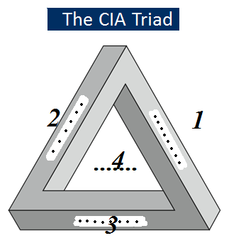
Exercises
Complete the figure and define each item giving an example on an ATM machine (2.5 Marks)
Notes:
Those who are “consumers” of computer security services and mechanisms (e.g.,
system managers, vendors, customers, and end users) desire a belief that the security
measures in place work as intended. That is, security consumers want to feel that the
security infrastructure of their systems meet security requirements and enforce security
policies. These considerations bring us to the concepts of assurance and evaluation.
The NIST Computer Security Handbook [NIST95] defines assurance as the
degree of confidence one has that the security measures, both technical and operational,
work as intended to protect the system and the information it processes. This
encompasses both system design and system implementation. Thus, assurance deals
with the questions, “Does the security system design meet its requirements?” and
“Does the security system implementation meet its specifications?”
Note that assurance is expressed as a degree of confidence, not in terms of a formal
proof that a design or implementation is correct. With the present state of the art,
it is very difficult if not impossible to move beyond a degree of confidence to absolute
proof. Much work has been done in developing formal models that define requirements
and characterize designs and implementations, together with logical and mathematical
techniques for addressing these issues. But assurance is still a matter of degree.
Evaluation is the process of examining a computer product or system with
respect to certain criteria. Evaluation involves testing and may also involve formal
analytic or mathematical techniques. The central thrust of work in this area is
the development of evaluation criteria that can be applied to any security system
(encompassing security services and mechanisms) and that are broadly supported
for making product comparisons.

Slide 27


